Slide 1
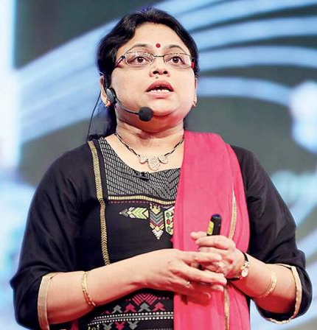
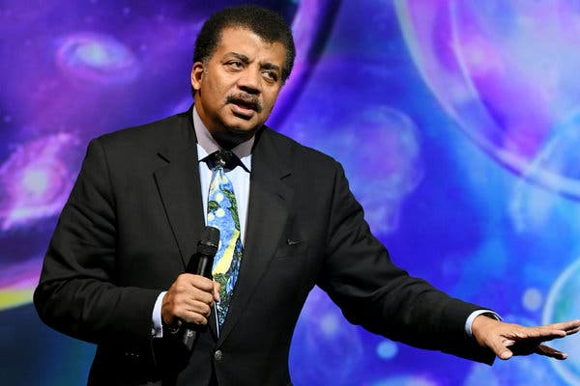
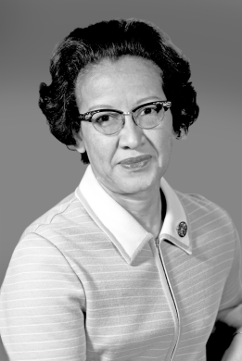
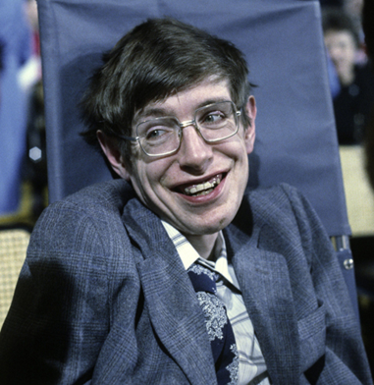
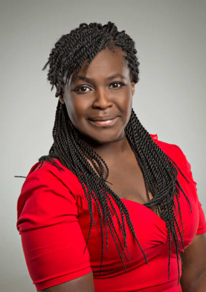
Space Hero Project!
You are to research and write a report about a famous Scientist and how their work and discoveries have helped to transform our understanding of space!
You will need to include, information about when and where the Scientist was born, their early life and education, what their famous space discoveries / work was about, the impact at the time of discovery maybe even the impact on our modern day lives. You could even discuss a scenario of how our lives / understanding would be different if their invention / discovery had not been made!
There are many scientists lost in history that made amazing contribution and deserve more celebration
There are many modern Scientists making fantastic contributions right now
Good luck Space Scientists!
Ritu
Karidhal
Neil
Degrasse Tyson
Katherine
Johnson
Stephen
Hawking
Maggie
Aderin-Pocock

